Slide 1

Amoun Language Schools School Management System (LMS)
Karim Ehab, Youssif Assem, Mohamed Moataz & Philip George
Supervised by: Dr. Essam Eliwa Supervising Assistant: Eng. Nada Ayman
1

Slide 2
Agenda:
SOFTWARE ENGINEERING (SE305)
Introduction
Problem Statement
Diagrams
System Overview
Architecture Diagram
Class Diagram
Design patterns applied
Sequence Diagram
Database Scheme
UI
Client Feedback
Live Demo
2

Slide 3
Introduction
3

Slide 4
Introduction:
When coronavirus conquered Earth at the end of 2019, all entities had gone online like: private and public companies, schools, universites, …etc.
No doubt, some education authorities in Egypt started e-learning especially universites. So, we decided to create not only learning system but also, a management one.
We believe that LMS in this pandemic time became something necessary all over the world.
4

Slide 5
Problem Statement
5

Slide 6
Problem Statement:
Online and e-learning systems for schools are a bit neglected. So when the pandemic hit our country. The online system was needed more than ever. It was not provided the way that the student needed it to be for him/her to benefit fully from it.
6

Slide 7
Diagrams

Slide 8
a) System Overview
8

Slide 9
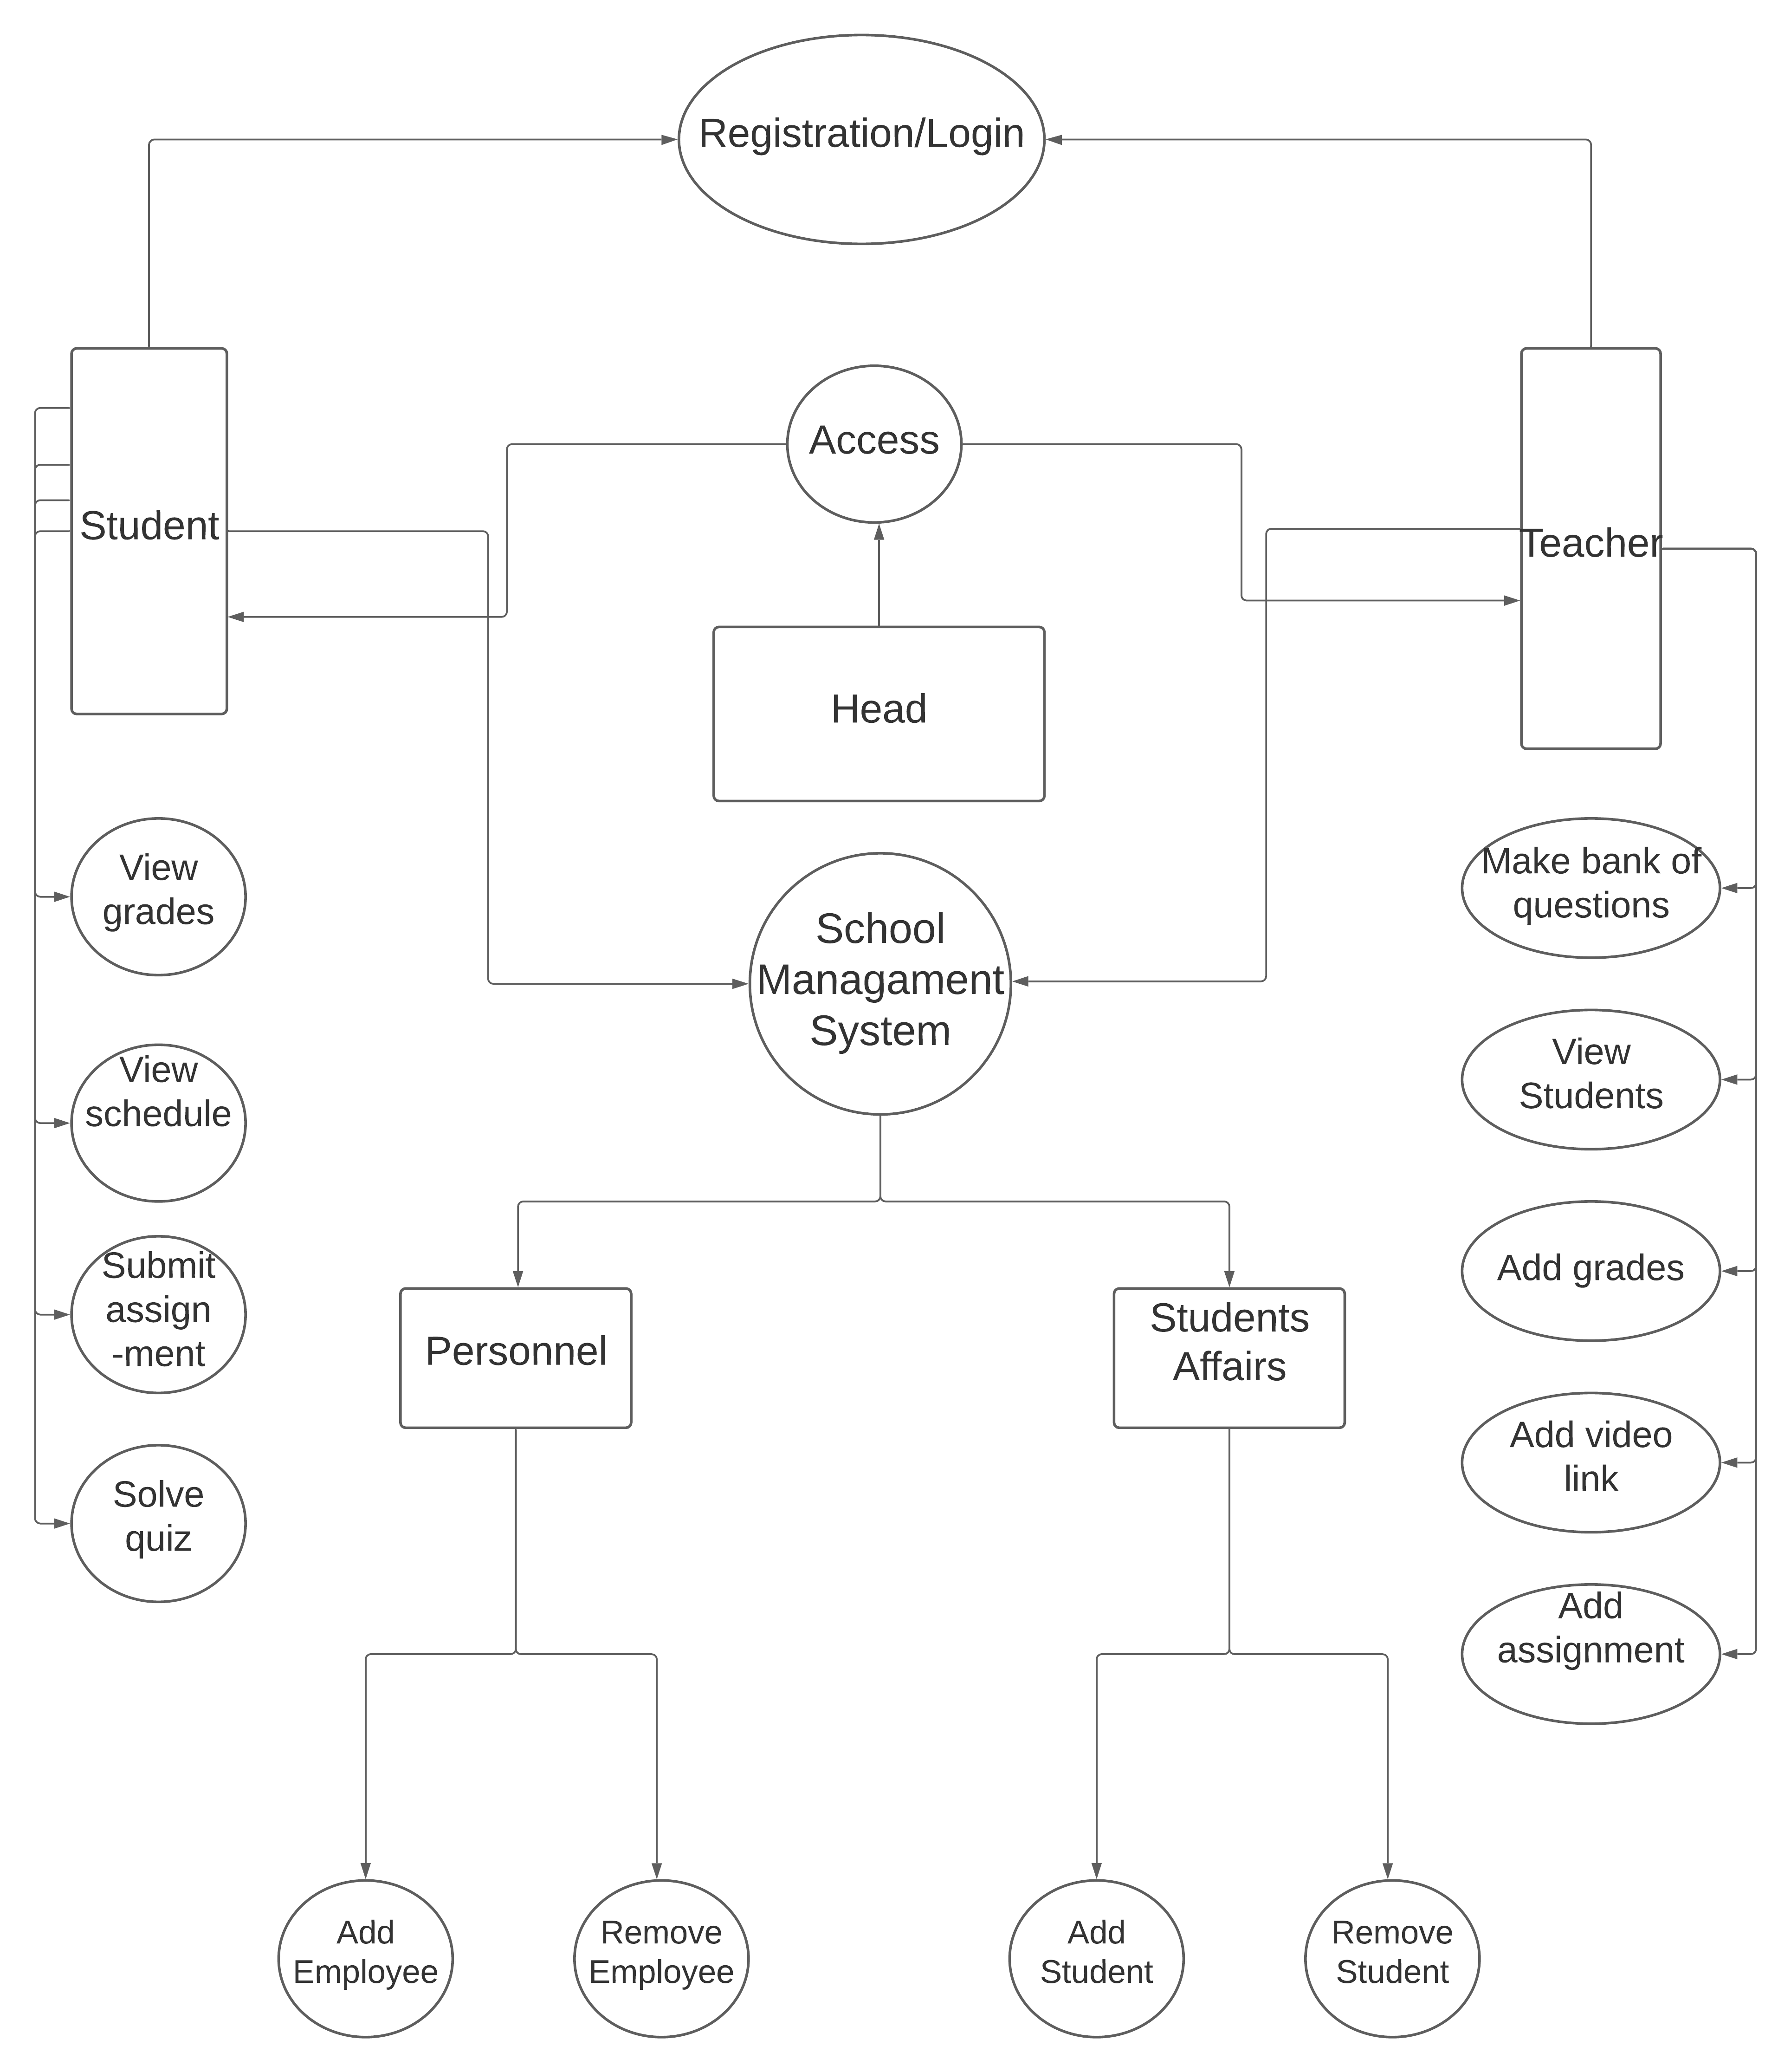
9

Slide 10
Database Diagram
10

Slide 11
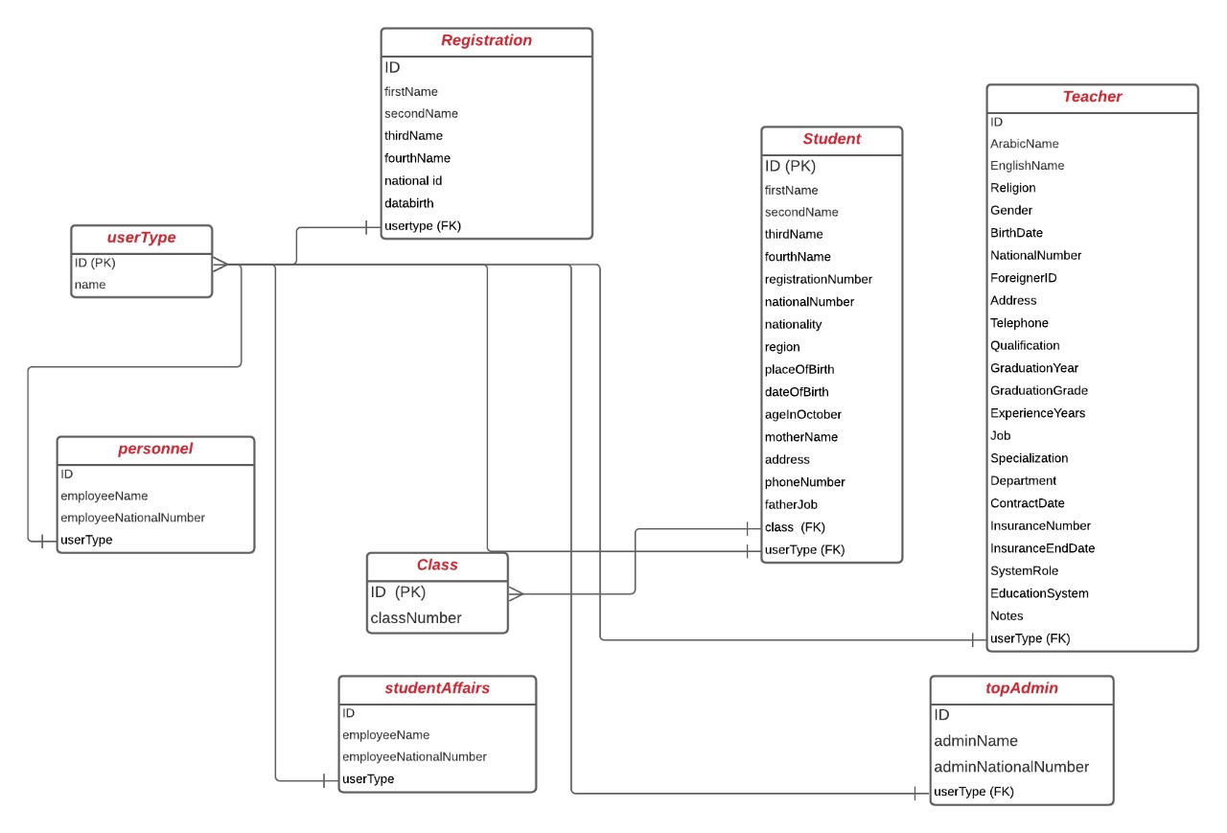
Database Diagram:
11

Slide 12
Class Diagram
12

Slide 13
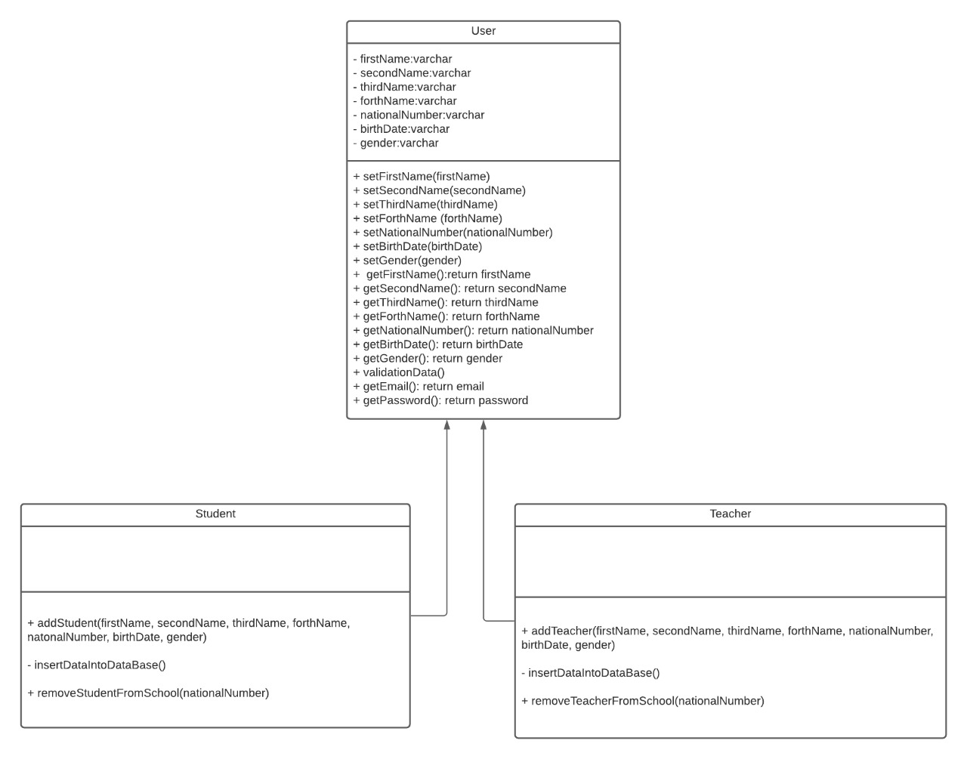
Class Diagram:
13

Slide 14
Wireframes and Prototypes
14

Slide 15

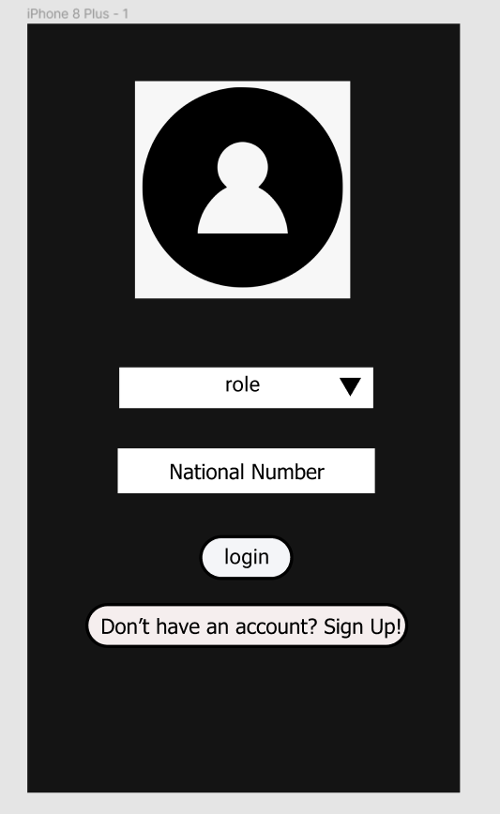
Prototype(1/2):
We gave samples on different platforms.
15

Slide 16
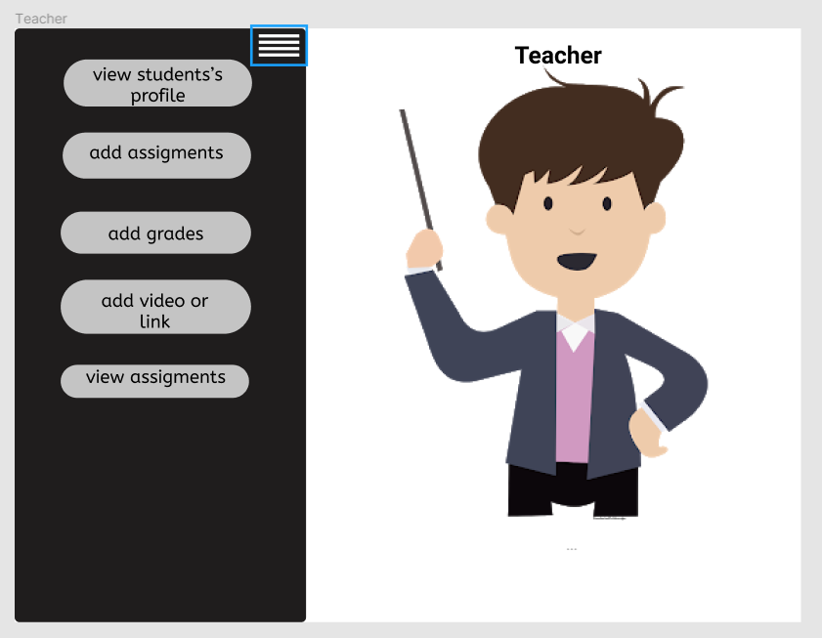
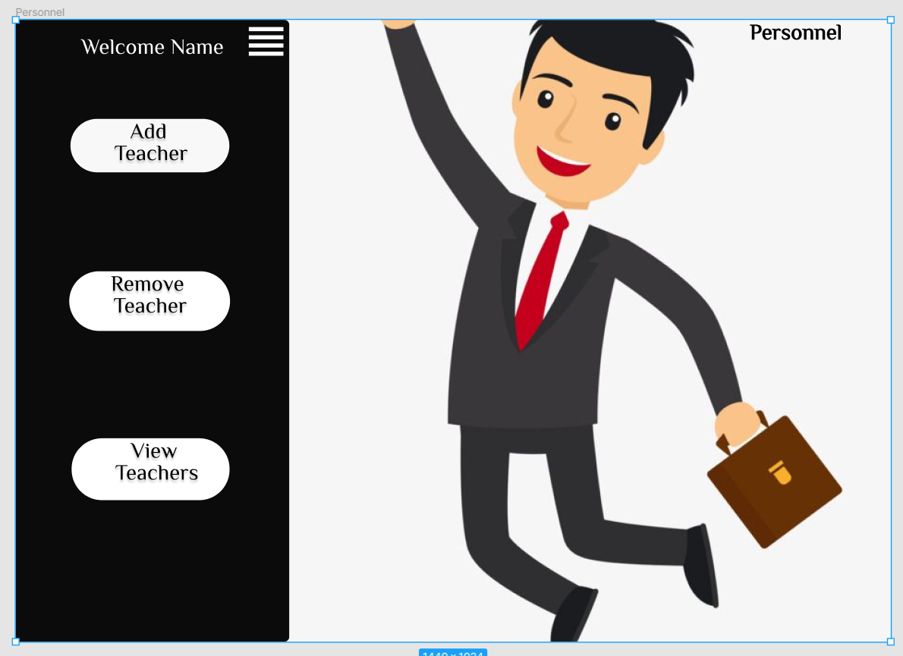
Prototype(2/2):

Slide 17
Live Demo
17

Slide 18
